Slide 1
E-Commerce Project

Slide 2

E-Commerce Project
Mentor and Team Members
Mentor: Team Members:
B harish Baisakhi Barik
Diksha Singh
Abhijeet Chaudhary
Nikhil Uttam Labde
Anuja Pandurang Amrutard
Tadimalla Sai Saradind
Mohd Abdul Aabid

Slide 3
KPI 1
Weekday Vs Weekend Payment Statistics
KPI 2
KPI 3
KPI 4
KPI 5

Slide 4
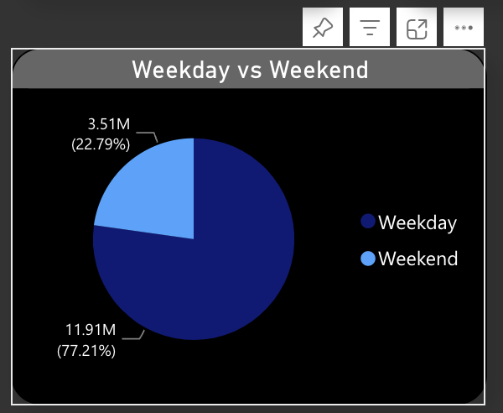
This is the 1st KPI for the Weekday vs. weekend Payment Statistics.
While creating this graph we added the columns of Weekday/Weekend in the power query by using a conditional column. For this KPI we have taken two datasets which is olist_order_payment_dataset and olist-order_dataset.
In this visualization, we have taken the column of Weekday/Weekend and the sum of payment values.
As we can see in the pie chart the payment on the weekday is 11.91M and on the Weekend is 3.51M.
Weekday Vs Weekend Payment Statistics
KPI 1

Slide 5
Weekday Vs Weekend Payment Statistics
Count orders with a review score of 5 and paid with a credit card
KPI 1
KPI 2
KPI 3
KPI 4
KPI 5

Slide 6
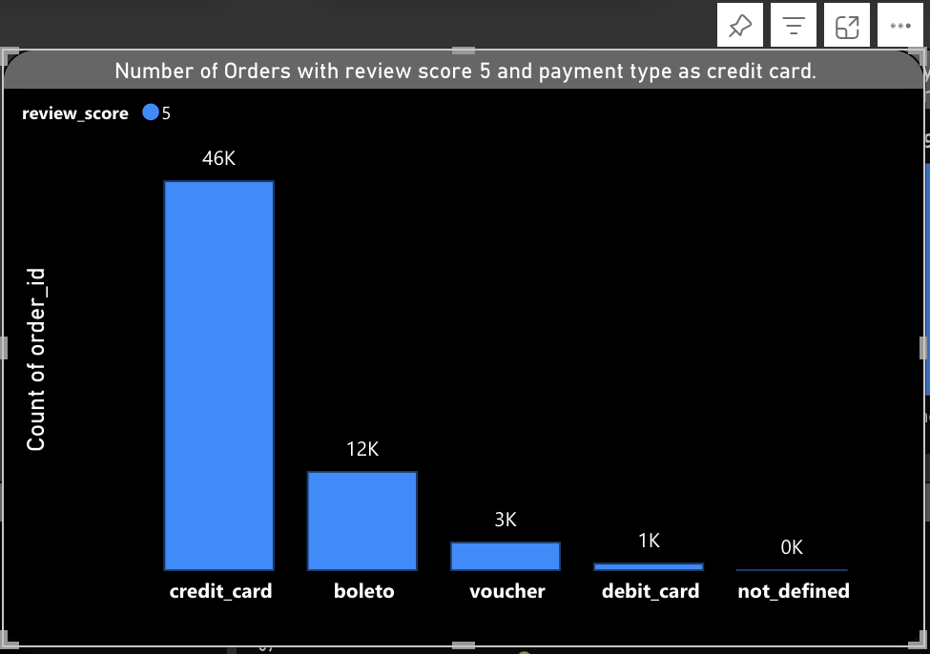
This is the 2nd KPI to know the Number of Orders with a review score of 5 and Payment type as Credit Card. For this KPI we have used the Stacked Bar Chart. For this visualization, we have taken two datasets that is order_payments_dataset and Order_review_dataset.
In the visualization, we use Payment Type in the Y-Axis and Order_ID in the X-Axis. So, we got some numbers that are the payment type as the credit card has more than other types of payment and also, we can see the review score is also very high in credit card.
Count orders with a review score of 5 and paid with a credit card
KPI 2

Slide 7
Weekday Vs Weekend Payment Statistics
Count orders with a review score of 5 and paid with a credit card
Calculate the average delivery time for orders in the pet shop
KPI 1
KPI 2
KPI 3
KPI 4
KPI 5

Slide 8
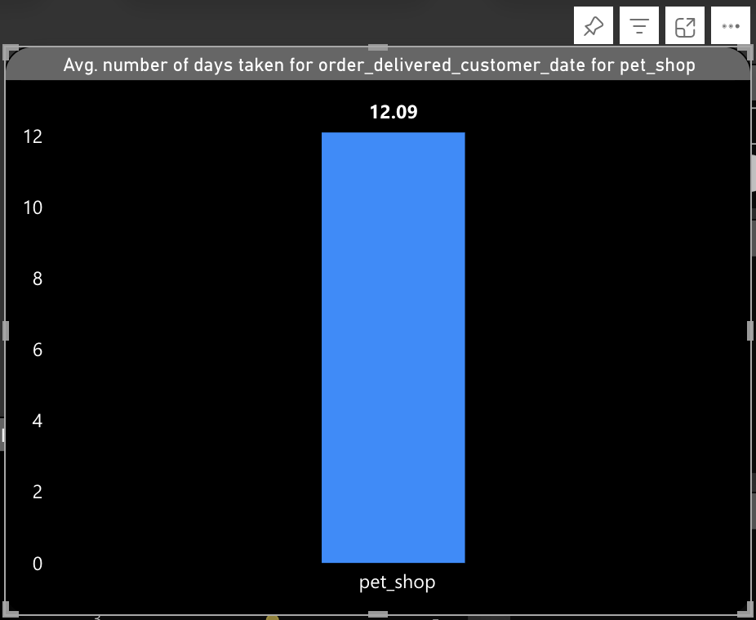
This is our 3rd KPI for the Avg. Number of days taken for order_delivered_customer_date for the pet shop.
We have used the Stacked Column Chart for this KPI. In this KPI we have taken two datasets which is
# Olist_order_dataset
# Olist_product-dataset.
To get the the perfect number of shipping days transform the data again to add the shipping days column. In the power query, we go in the add colun function and use the Custom Column function in that we have done subtraction of two columns from Olist order _dataset which is order_delivered_customer_date - order_purchase_timestamp.
So, we have taken Avg. Shipping days in the Y-Axis and Product category name to get the accurate number. So, the Average number we got is 12.09 Days.
Calculate the average delivery time for orders in the pet shop
KPI 3

Slide 9
KPI 1
Calculate the average delivery time for orders in the pet shop
Average price and payment values from customers of Sao Paulo City.
Weekday Vs Weekend Payment Statistics
KPI 2
Count orders with a review score of 5 and paid with a credit card
KPI 3
KPI 4
KPI 5

Slide 10
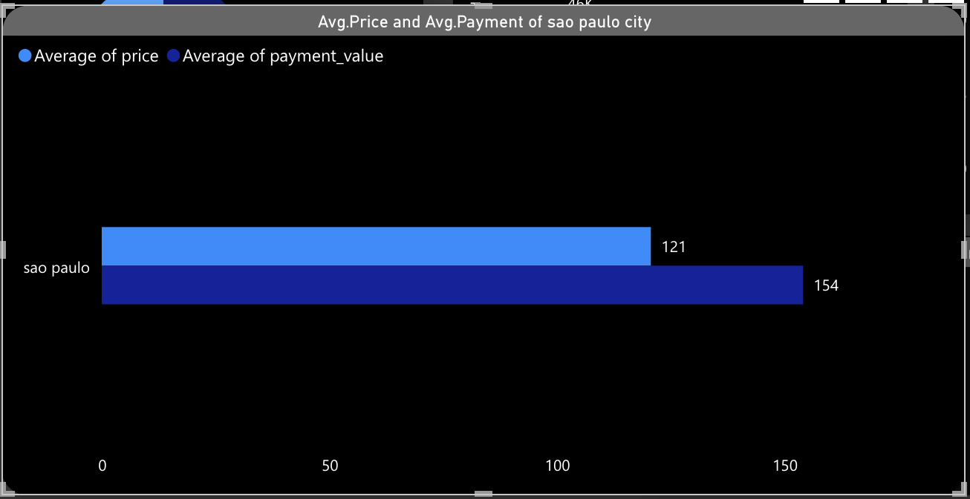
This is our 4th KPI to get the Average price and payment values from customers of Sao Paulo City. For this KPI we choose a Clustered Column Chart because we can check the comparison between the price and Payment values for the customers of Sao Paulo City. For this visualization, we have used three datasets that are:
olist_customer_dataset
olist_order_items_datset
olist_order_payment_dataset
To get the perfect numbers we have taken customer_city in the X-Axis and Average of price and average of payment value in the Y-Axis.
According to the chard displayed the average price and average payment of Sao Paulo City have shown that the number of payment is greater than the price in the Sao Paulo City.
Average price and payment values from customers of Sao Paulo City.
KPI 4

Slide 11
KPI 1
Calculate the average delivery time for orders in the pet shop
Average price and payment values from customers of Sao Paulo City.
Explore the correlation between shipping days and review scores.
Weekday Vs Weekend Payment Statistics
KPI 2
Count orders with a review score of 5 and paid with a credit card
KPI 3
KPI 4
KPI 5

Slide 12
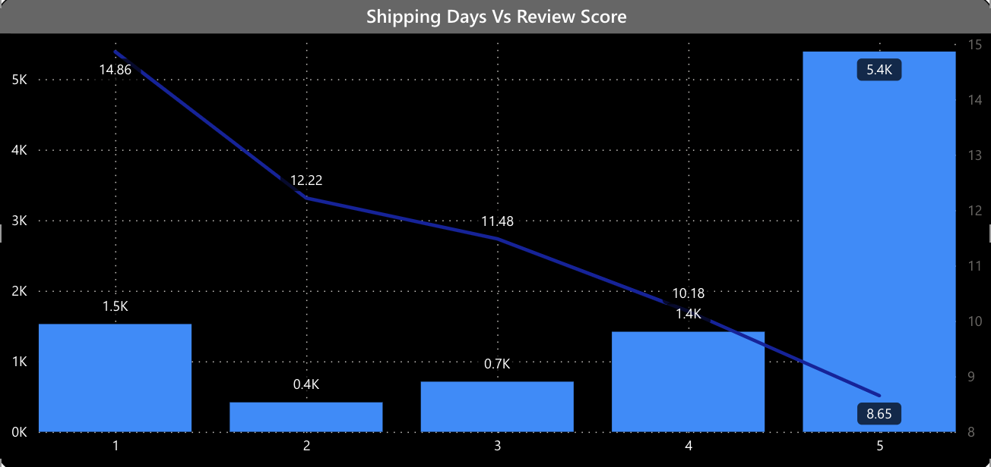
Dashboard
This is the 5th KPI to show the relationship between shipping days and Review Scores. For this KPI we have used Line and Stacked column Chart to show the trend and relation between shipping and review score. In this visualization, we have used olist-order_payment_dataset and olist_orders_dataset.
Then we took review scores in the X-Axis and the Y-Axis we took the Average of Shipping Days.
So, the conclusion is that when the shipping days is more then the review score is less, and when the shipping days are less then the review score is high.
Explore the correlation between shipping days and review scores.
KPI 5

Slide 13
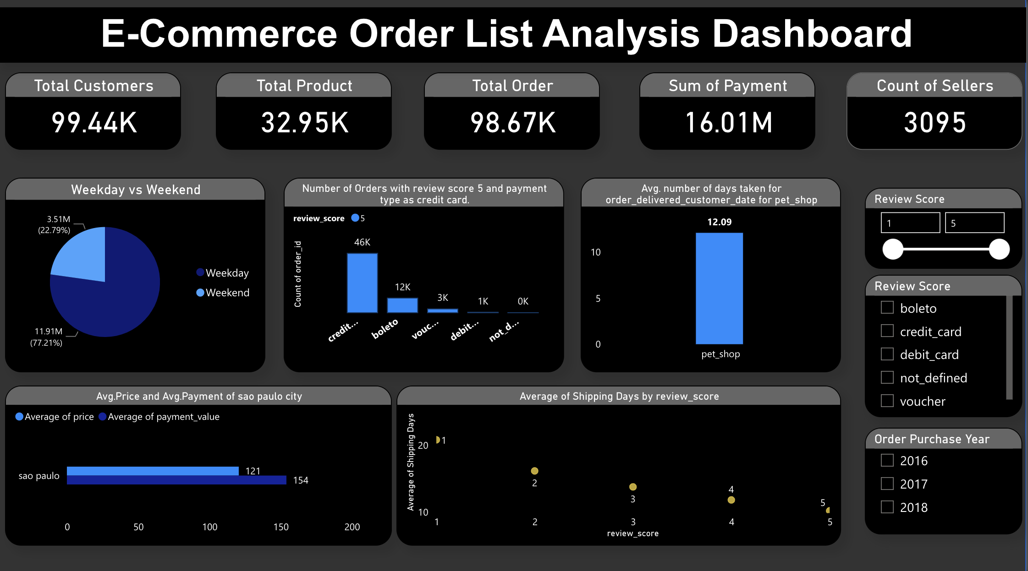
Dashboard

Slide 14
Thank You

